Slide 1
Analyzing Neighborhoods in Bangalore, India for Opening a Shopping Mall
By : Foram Jivani
Date : 19 Apr, 2021

Slide 2
Business Problem
Bangalore, officially known as Bengaluru, is the capital and the largest city of the Indian state of Karnataka and is one of the most densely populated cities in the world.
However, there are not many shopping malls in the city. And the current traffic problems in bangalore make it difficult for people to go for shopping mall which is at far end of city where they are living. Moreover it takes half a day to travel to famous shopping malls in Bangalore.
Aim of this project is to study the neighborhoods in Bangalore to determine possible locations for opening a shopping mall.
Useful for business owners and entrepreneurs who are looking to invest in a shopping mall in Bangalore.
The main objective of this project is to carefully analyze appropriate data and find recommendations for the stakeholders.

Slide 3
Data Acquisition
Neighborhoods Data
Taken from https://kaggle.com The data is read into a pandas data frame using the read_csv() method.
Geographical Coordinates
The geographical coordinates for Bangalore data has been obtained from the GeoPy library in python. This data is relevant for plotting the map of Bangalore using the Folium library in python. These coordinates are then further used for plotting using the Folium library in python.

Slide 4
Data Acquisition
Venue Data
Extracted using the Foursquare API. This data contains venue recommendations for all neighborhoods in Bangalore and information about venues inside each and every neighbourhood within 1000 meters.
The information obtained per venue as follows:
1. Neighbourhood : Name of the Neighbourhood
2. Neighbourhood Latitude : Latitude of the Neighbourhood
3. Neighbourhood Longitude : Longitude of the Neighbourhood
4. Venue : Name of the Venue
5. Venue Latitude : Latitude of Venue
6. Venue Longitude : Longitude of Venue
7. Venue Category : Category of Venue

Slide 5
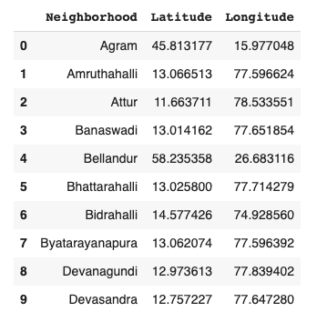
Dataset for Bangalore Neighborhoods
Figure : First 10 rows of Bangalore Neighborhood Dataframe

Slide 6
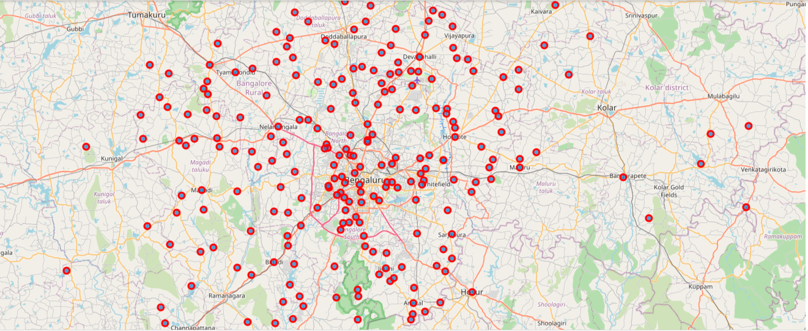
Map of Neighborhoods in Bangalore

Slide 7
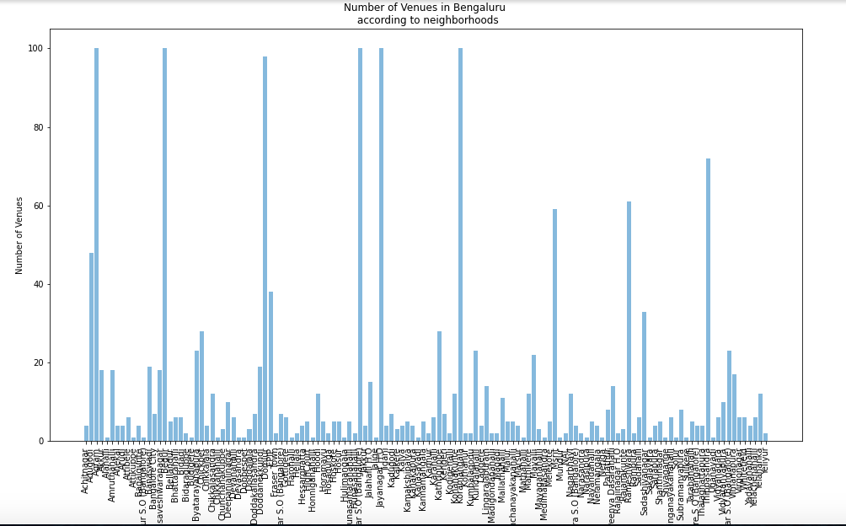
Number of Venues vs Neighborhoods

Slide 8
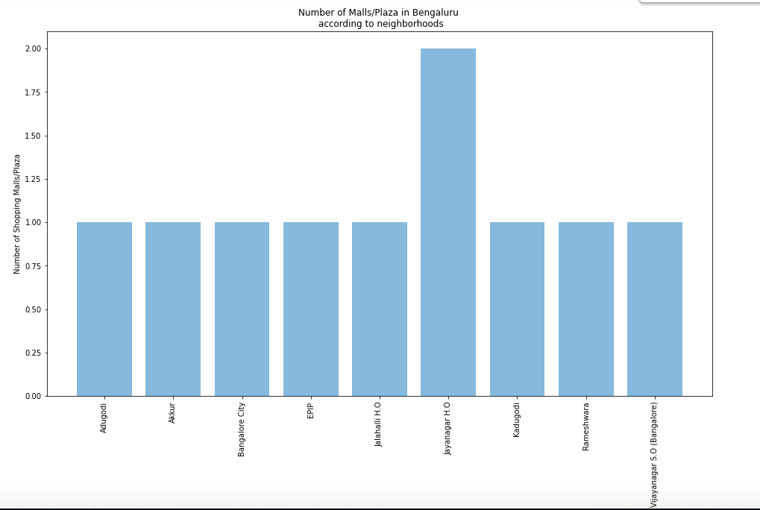
Number of Shopping Malls/Plaza vs Neighborhoods

Slide 9
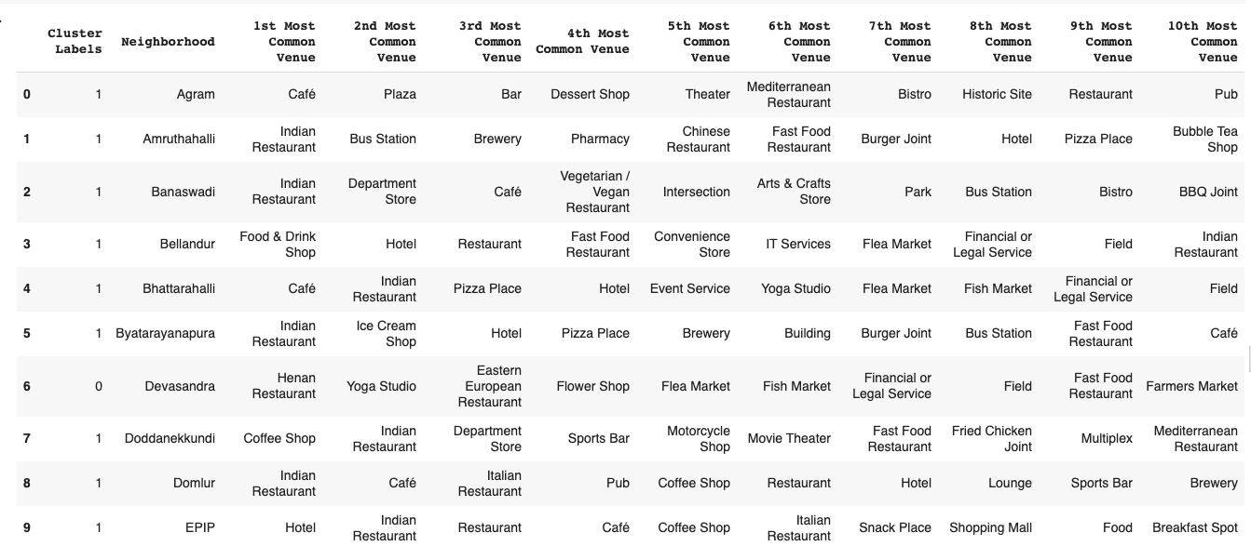
Dataset for Top 10 Most Common Venues
Figure : First 10 rows of top 10 most common venues for all neighborhoods

Slide 10
Methodology
Main idea behind suggestion for shopping mall/plaza is first we select areas where there are less number of shopping mall/plaza or area which contain a small percentage of shopping mall/plaza, departmental stores or miscellaneous shops in their top 10 common venues.
In order to solve this problem, we are going to employ KMeans Clustering algorithm.

Slide 11
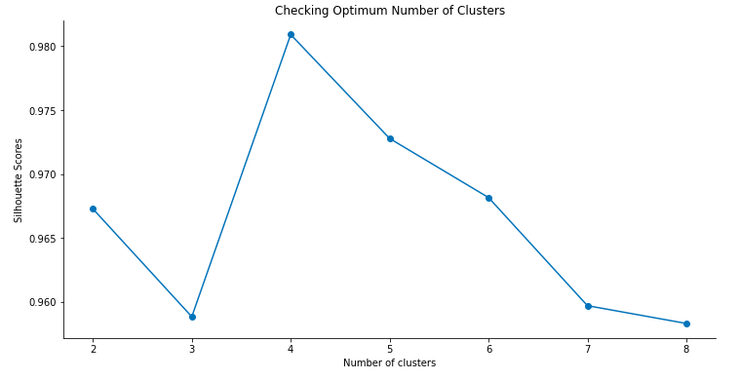
Methodology
Unsupervised Learning Model
KMeans clustering was used to cluster neighborhoods in Bangalore based on Shopping Mall Venue.
The plot shows a maximum Silhouette Score for 4 clusters and thus the n_clusters parameter in KMeans clustering was set to 4

Slide 12
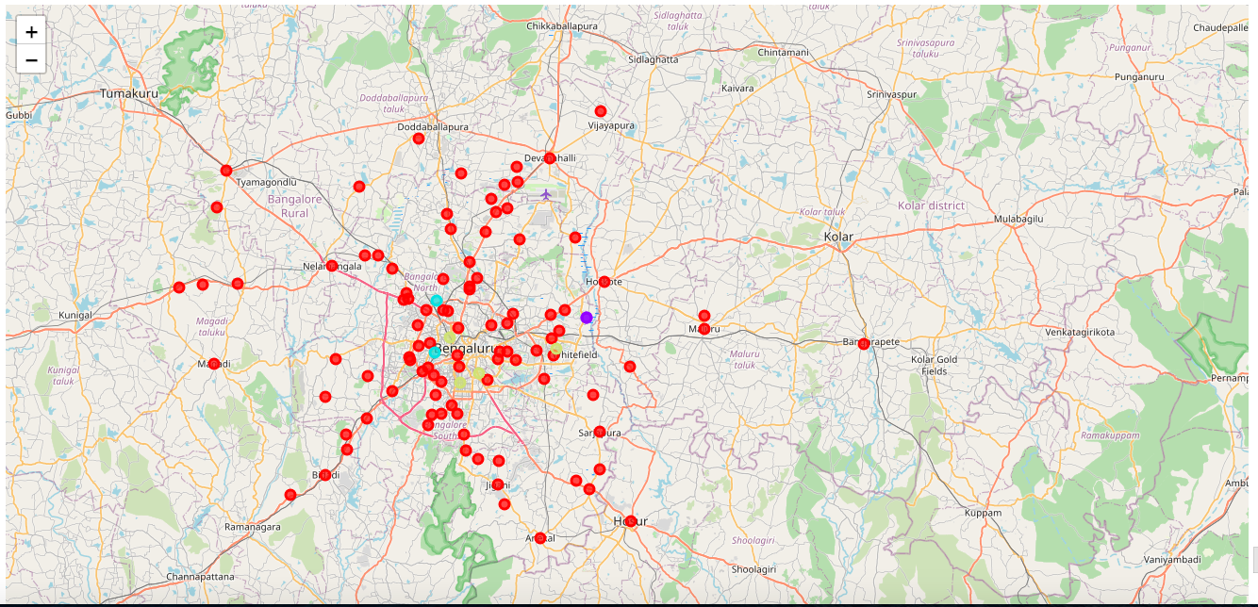
Clustering Neighborhoods having any shopping Mall/plaza

Slide 13
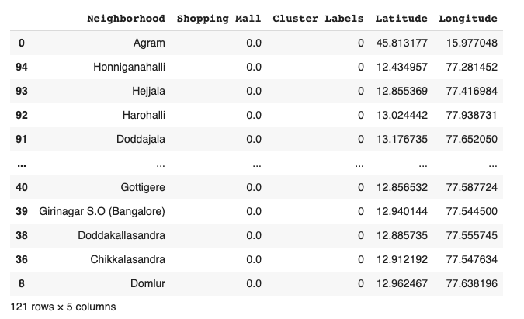
Results
Cluster 1

Slide 14
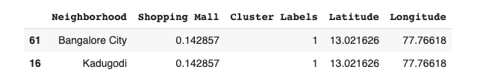
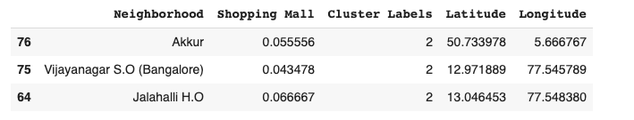
Result
Cluster 2
Cluster 3

Slide 15
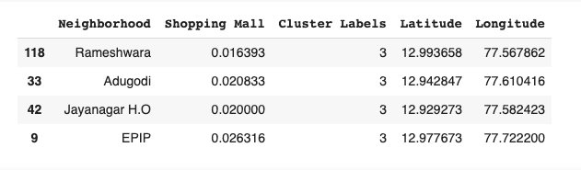
Result
Cluster 4

Slide 16
Result & Discussion
Visualization of neighborhood clusters was done using Folium in python.
Different clusters correspond to different colors in image.
By analyzing the clusters, it is evident that neighborhoods in cluster 2, 3, and 4 are not well suited for a new shopping mall since they contain enough number of shopping mall.
Clusters 1 does not contain any shopping mall and those neighborhood are good choice to open new shopping mall.
Thus, the most optimal neighborhoods for opening a shopping mall are in cluster 1

Slide 17
Future Work & Conclusion
We came to know which neighborhoods are good choice for new shopping mall we can also look into its top venues and rating of those venues to select final few locations to open a new shopping mall.
In this project, the neighborhoods in Bangalore, India have been successfully analyzed for determining which would be the best neighborhoods for opening a new shopping mall.
Based on the analysis, neighborhoods in cluster 1 are recommended as locations for the new shopping mall.
The stakeholders and investors can further tune this by considering various other factors like transport, legal requirements, and costs associated which were out of the scope for this project and thus were not considered.

Slide 18
Thank you

